Slide 1


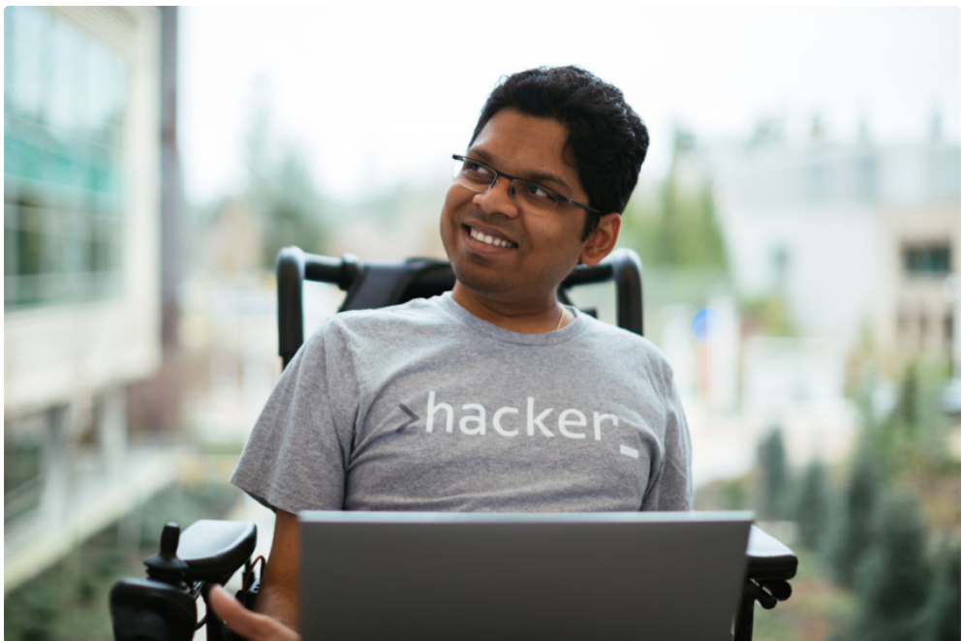

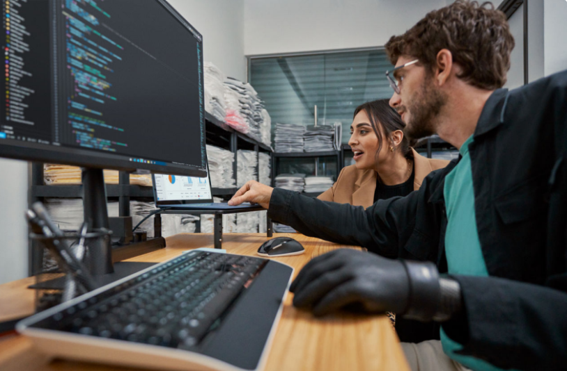

Embark on Microsoft’s AI Odyssey and become an AI master!
Learn new AI skills, earn certificates, and win VIP passes to attend Microsoft AI Tour and meet industry experts
Submit your details
Note: Submit your details only when you complete both levels of the challenges
Microsoft’s AI Odyssey is a great way to start the new year with a bang! This challenge is designed for developers and spans the entire month of January 2024. It’s a great opportunity to learn new skills and advance your career in the field of AI. Complete the challenges and take the first step towards becoming a subject matter expert in AI.
How to Qualify
AI Odyssey has two levels of challenges. You can complete one or both levels, depending on your goals and interests.
Both levels must be completed to have a chance for a VIP Pass to AI Tour.
Level 1: Complete AI Skills Challenge
Level 2: Earn AI Applied Skills Credentials
In this level, you will learn how to create and deploy AI solutions for various situations using Azure AI services, such as detecting emotions, faces, or forms. You will also find helpful learning materials, code examples, and guides to assist you.
In this level, you will demonstrate your ability to apply the AI skills learnt in Level 1. Earn your credential by passing an online, on-demand assessment that requires you to complete a series of tasks in an interactive lab experience.
To finish level 1, complete the listed AI Skills Challenges
To finish level 2, earn all the listed applied skills credentials.
Build a natural language processing solution with Azure AI Language
Build an Azure AI Vision solution
Create an intelligent document processing solution with Azure AI Document Intelligence
Build a natural language processing solution with Azure AI Language
​Build an Azure AI Vision solution
Create an intelligent document processing solution with Azure AI Document Intelligence
Upon successfully finishing Level 1, you will be awarded the AI Odyssey Completion Certification from Microsoft.
Display this prestigious certification with pride!
Upon successfully passing the assessments you will earn Microsoft-verified credential certificate that you can share on your LinkedIn profile to show your trustworthy skills to organizations.
Campaign Terms and Conditions
For a chance to win a VIP Pass to the AI Tour, ensure you have completed both Level 1 and level 2 of AI Odyssey Challenge.
To validate your eligibility, share your completion details with your admin
Submit Your details
Need help? write to

Slide 2
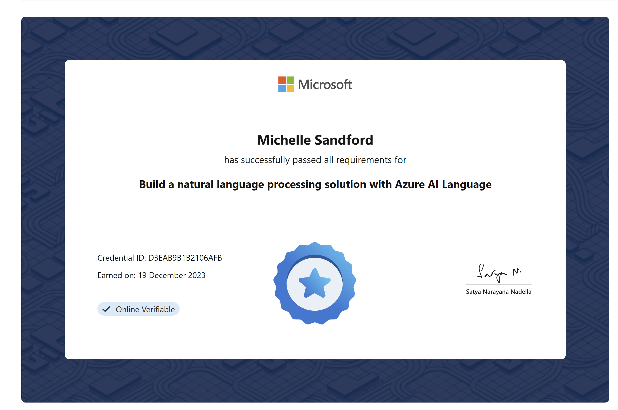
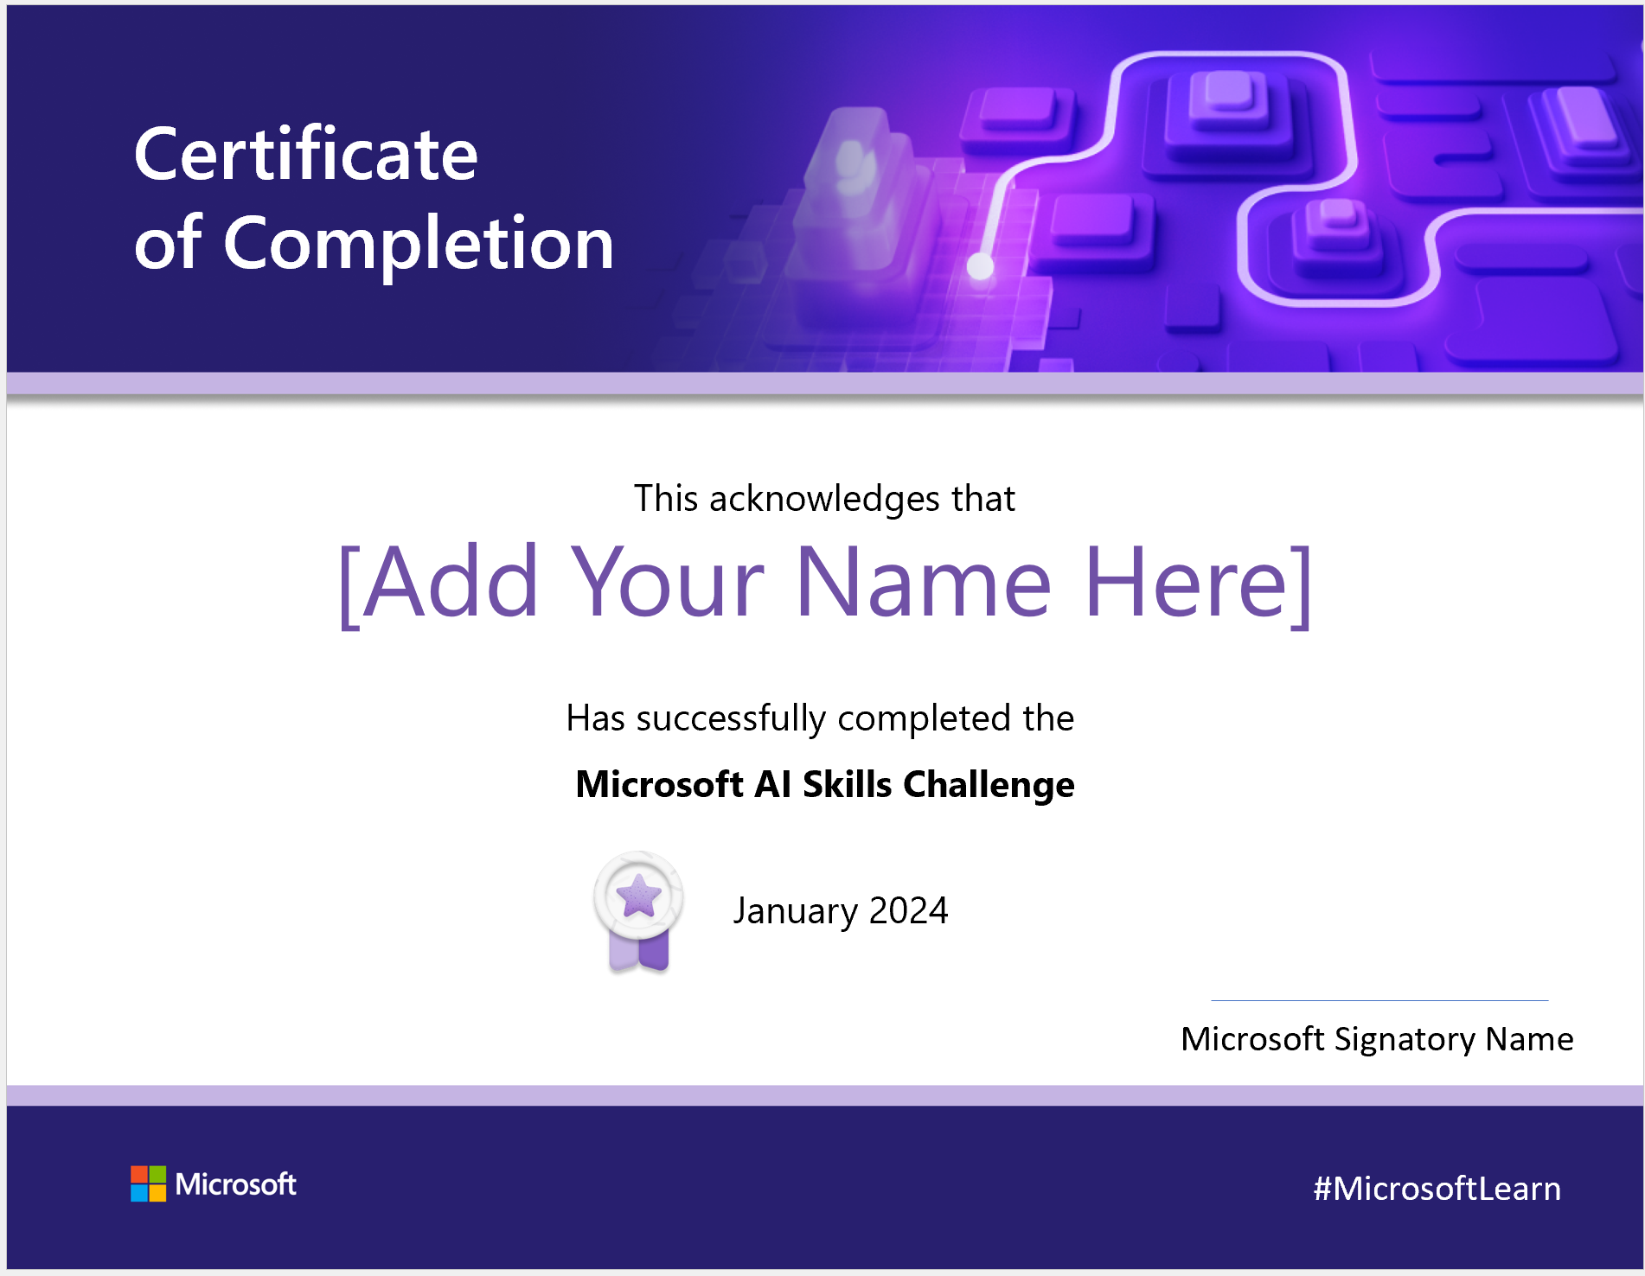
Applied Credentials Certificate
AI Skills Challenge Completion certificate

Slide 3
AI Odyssey Challenge : Help Videos and Resources
What is the Duration of the Ai skill challenge and Assessments
The learning path has an average duration of 5 hours
Most Microsoft Applied Skills assessment labs for a given scenario typically contain 12-16 tasks;
You will have 2 hours to complete the lab. Each applied skills will take an average of 70-90 min depending on your skill profiency.
Multiple attempts ( reattempt gets activated after 72 hours of previous attempt).
What is the format of these assessments
Earning a Microsoft Applied Skills credential demonstrates your proficiency in a specific, scenario-based skill. Assessments are
Free of Cost
Un-proctored available on MS Learn
Multiple Attempts
Where are my applied Skill credentials be stored?
All applied skills certificates are stored under your MS learn profile à Credentials tab.
Additional Resources
Applied Skill assessment : Watch this tutorial for the step-by-step guide
Applied Skill FAQ : Microsoft Applied Skills process overview | Microsoft Learn
Assessment lab duration : Assessment lab duration and lab experience | Microsoft Learn
Assessment Scoring FAQ : Assessment lab scoring and score reports | Microsoft Learn

